Slide 1
Successful Journal Submission
Notes:
This next section will cover the important points to keep in mind to successfully submit your manuscript to the journal.

Slide 2
Journal editors are busy!
Most journal editors are not full-time journal editors
Full-time professors
Department heads
Journal editors when they have time
You are competing with many other researchers for the journal editor’s limited time
Notes:
However, journal editors are very busy! Most are not full-time editors, but full-time professors and heads of departments. That means you are competing with other researchers for their limited time.
Therefore, having an efficient publication strategy means that you effectively communicate the suitability of your study to them.
Make the information they need to evaluate your paper easy to understand in your cover letter.

Slide 3
Make the best first impression for journal editors
Cover letter
Significance and relevance of study
Suitable to be published by their journal
Interesting to their readers?
Clear and concise writing style?
Notes:
First impressions are important when you have limited attention from journal editors.
It is the first time they can evaluate the significance and relevance of your study. This is how they determine if your manuscript is suitable to be published by their journal. If not, they have many other options to choose from.
They also want to ensure your study will be interesting to their readers. Journal editors want to improve the reputation of their journal in the field. To do this, their published articles need to be widely read.
Lastly, this is the first time they can evaluate your writing style. If you cannot clearly communicate the significance and relevance of your study in your cover letter, they will assume—based on their first impression—that you cannot do so in your manuscript either.

Slide 4
Cover letters – What to include (~1 page)
Introduce your manuscript
Manuscript title
Article type
Why study is important
Brief background
Research problem & aims
What you found
Study design
1 or 2 key findings
Why suitable for the journal
Conclusion
Interest to the readership
Additional information
Include/exclude reviewers
Publication ethics
Notes:
So what information journal editors need when evaluating the suitability of your manuscript?
They want to know the title of your manuscript, but also tell the journal editor the type of article it is. Journals publish a variety of article types (research articles, short communications, review articles, letters to the editor), and each is evaluated differently. Let the journal editor know the type of article your manuscript is at the beginning of your cover letter.
You next need to briefly describe why the study needs to be done. Introduce the topic of the study and what challenges researchers are facing regarding this topic.
Then concisely discuss your study. Your study design and highlight the one or two most important findings. This is to emphasize why your study is important to the field.
Next, you need to convince the journal editor that your manuscript will be interesting to the journal's readers. Remember, that is an important issue for the journal editor! I recommend to review the aims and scope of the journal, and be sure to include any key topics or readers that are emphasized. This will help establish the suitability of your manuscript, and why the journal editor should choose your manuscript over the many others that have also been submitted.
Finally, it is also a good idea to recommend 3 or 4 potential reviewers for your manuscript. Some journals require this, so be sure to read the author guidelines carefully. But even if they don’t require it, it’s always a good idea and can help speed up the submission process because finding qualified reviewers can often take time for the journal editor. You can also exclude reviewers as well to avoid an potential conflicts of interest during the review of your manuscript.
Lastly, you should highlight important issues related to publication ethics, which we will discuss on the next slide in more detail.
In the end, you will have a logically written cover letter emphasizing the significance and relevance of your study for the journal editor—increasing your chances of publication success.

Slide 5
Publication ethics
Original and unpublished
Not submitted to other journals
Authors agree on paper/journal
In your
cover letter
Conflicts of interest
Source of funding
Authorship contributions
Notes:
Include information about publication ethics at the end of your cover letter.
You should state it is original and unpublished.
It is not being reviewed by any other journals—you can only submit to one journal at a time.
Journal editors don’t like author conflicts. Therefore, state that all the authors agree on the content of the journal and the authorship order. Further, it is useful to state that all the authors agree with the submission to the journal.
If you have any conflicts of interest, you should state them here.
You should also include the source of your funding.
Lastly, some journals will require you to state what each author contributed to qualify to be an author on the manuscript.
So be sure to include this valuable information for the journal editor in your cover letter, and they will know you have followed the guidelines for publication ethics used worldwide.

Slide 6
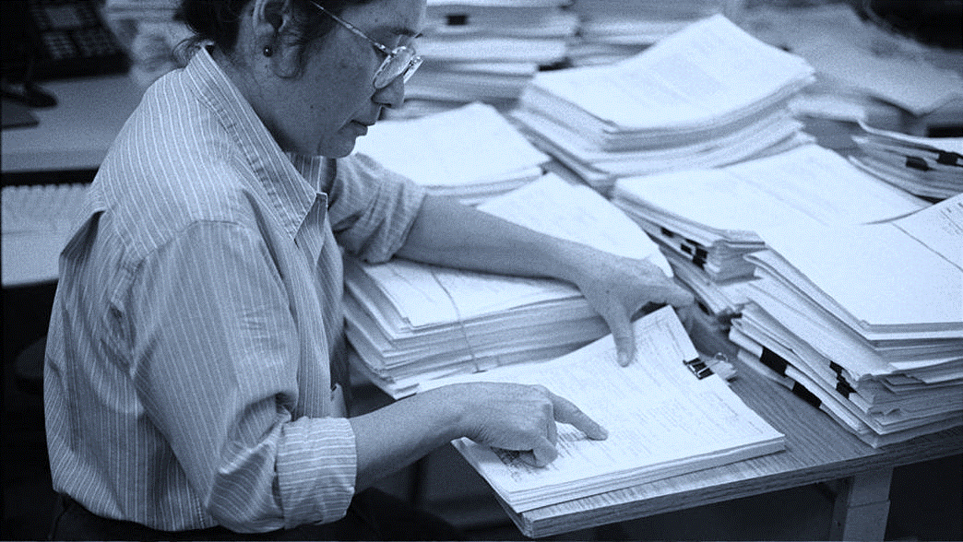
Convince journal editor manuscript is suitable
Peer review
Notes:
Now that you have convinced the journal editor that your study may be suitable for publication in their journal, you have overcome the first obstacle in publishing. The next obstacle you have to face? Peer review.

Slide 7
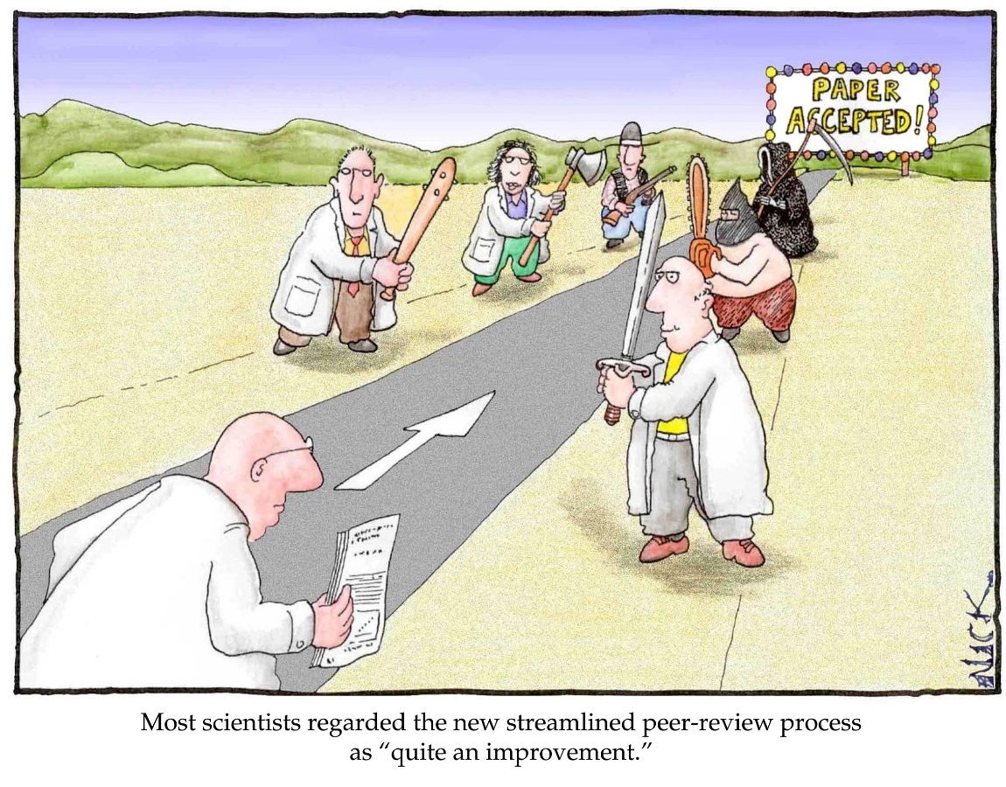
Peer review is a positive process
Experts give advice on how to improve your study and your manuscript
Ensures only relevant studies are published
Peer review helps to advance the field
Cartoon by Nick D Kim, scienceandink.com. Used by permission.
Notes:
Although many authors view peer review like this (point to comic), please remember that peer review is a positive process.
During peer review, experts in your field take time out of their busy schedules to give you their advice on how you can improve the quality of your study and your manuscript—and they do this for free!
By being externally reviewed, peer review ensures that only those studies that are most relevant for field and that are scientifically sound are published.
This process then can directly influence the advancement of the field.

Slide 8

The journey of your manuscript
Author
Editor
Reviewer
Submit manuscript
Meets basic requirements?
Yes
Assign reviewers
Evaluate and recommend
No
Assess comments
No
Revise manuscript
Make decision
Revise
Yes
Notes:
Peer review is an essential step in the journey of your manuscript. However, it is important to remember that journal editors still play the essential role and make the final decisions.
The first decision they will make is whether or not your manuscript meets the basic requirements for their journal. If not, they will not even send it for review. If they feel it may be suitable for their journal, then they will find reviewers to evaluate your manuscript.
These reviewers will then give their recommendations on how the manuscript can be further improved and whether they feel it is suitable for publication. The journal editor will then assess these comments and decide whether to reject the manuscript, or send it back to the author for revisions.
After revisions, the author will send back their improved manuscript for another round of evaluation. If the journal editor feels that all the reviewer comments have been addressed, only then will the journal editor accept the manuscript. In some cases, the manuscript may even go through another round of peer review to be safe.
So while the reviewers play an essential role in this process, it is the journal editor that makes the final decision.

Slide 9
Writing response letters
Clearly discuss all of your revisions
Most common mistake
Only state that revisions have been done, not what the revisions were
Journal editors are very busy!
Briefly state what was revised
Always refer to page and line numbers
In manuscript, highlight revised text
Make revisions easy to review
Notes:
Therefore, you have to ensure the journal editor has all the information they need to make their decision. This is done in the response letter after revision.
One of the most common mistakes that authors make in the response letter—that journal editors hate—is only saying that the revision was done. Not what the revisions were.
Please remember journal editors are very busy people! They don’t have time to hunt for your changes in your revised manuscript. You need to make it easy for them to assess if you have fully revised your manuscript according to the reviewer comments.
So be sure to state in the response letter what was revised and where those revisions can be found. In your revised manuscript, make the changes easy to see too; e.g., you can highlight the revised text. This will facilitate the review process and can help you publish more quickly.

Slide 10
Writing response letters
What are journal editors looking for?
Do you agree or disagree?
Why do you agree/disagree?
Support disagreement with evidence
What revisions were done?
State new experiments
How revised the text & figures
Where can revisions be found?
Page and line numbers
Updated figure numbers
Notes:
So what information are journal editors looking for in your responses?
They want to know why you agree or disagree. This shows them that you have understood the reviewer’s concern. If you do disagree, be sure to support your claims with evidence.
They want to know what revisions were made to the manuscript.
And they want to know where these revisions can be found.
By providing this valuable information, the journal editor can quickly determine if your manuscript has been fully revised and is it now ready to be published by their journal.

Slide 11
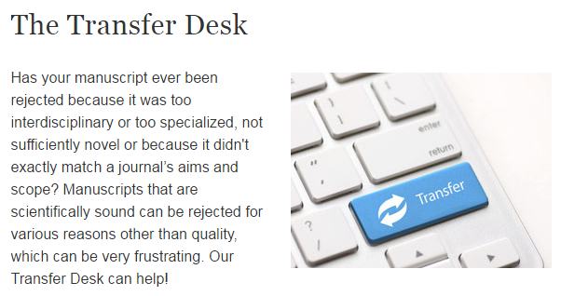

If at first you don’t succeed…
Relax, revise, and resubmit
And we can help!
https://www.springer.com/gp/authors-editors/journal-author/the-springer-transfer-desk
Notes:
Regardless of how good your study or manuscript is, you may still not be successful at your target journal. Remember, you have a lot of competition for limited space!
So what should you do if you are rejected? First, relax. Remember, this happens to everyone, so please do not take it personally. Next, learn from the experience. What didn’t they like about your manuscript? Can you revise it to improve it further? Lastly, resubmit your revised manuscript to another journal.
As publishers, we want to help you. Springer has an excellent Transfer Desk that can help you choose which journal may be right for you from our broad portfolio of journals.

Slide 12







Journal transfer at Nature
Notes:
Nature also uses a journal transfer service as well. If papers are rejected from Nature because the content is too specialized, Nature editors will recommend transferring your submission to a Nature research journal (such as Nature Photonics) if they feel the results are breakthroughs for the field, or to Nature Communications if they feel the results will have less impact. Manuscripts that are technically sound, but are not significant advancements for the field, would be recommended to be transferred to Scientific Reports.

Slide 13
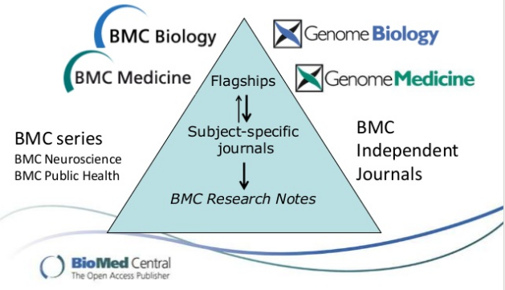
Journal transfer at BioMed Central
Notes:
Lastly, BioMed Central also has an established journal transfer service as well as shown here with the flagship journals at the top, from which manuscripts may be transferred to subject-specific journals or BMC Research Notes.

Slide 14


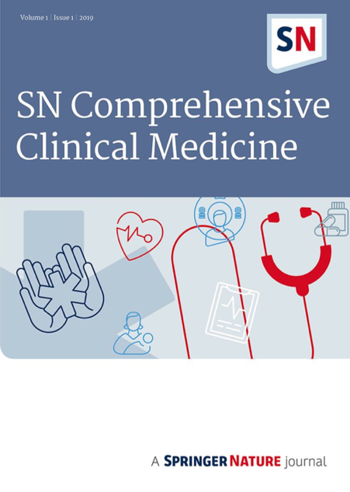
Journal transfer at Springer
Engineering, Materials Science, Physics, Chemistry, Earth & Environmental Sciences
Clinical medicine
Notes:
Nature also uses a journal transfer service as well. If papers are rejected from Nature because the content is too specialized, Nature editors will recommend transferring your submission to a Nature research journal (such as Nature Photonics) if they feel the results are breakthroughs for the field, or to Nature Communications if they feel the results will have less impact. Manuscripts that are technically sound, but are not significant advancements for the field, would be recommended to be transferred to Scientific Reports.

Slide 15
Promote your article after publication
Don’t wait for people to find it!
Present at conferences
Interact with others in your field
Key target audience
Establish new collaborations
Promote on social media
LinkedIn & Twitter
Use content sharing when available
Notes:
Now, if your article is published…don’t just passively sit back and wait for readers to stumble upon their article online! They may not!
You need to actively promote it to the field.
You should attend conferences to discuss your work. You will be able to interact with your peers face-to-face to discuss your recent studies. These are also likely your target readers, so let them know what you have published in increase your visibility in the field. By doing so, you will not only improve your impact, but you will likely establish new collaborations that can further improve your reputation and publication output as well.
But you should also promote your article on social media as well…this is now the digital age! You can promote your recently published work (via a link to the article on the publisher’s site) on LinkedIn or Twitter to more broadly reach readers worldwide.
Please keep in mind, however, although social networks are great for open access articles (because people do not need to log in to read your paper), they can be a burden for subscription articles. Springer Nature has addressed this important issue with our new platform of content sharing.

Slide 16
Content sharing
Allow anyone to read your article
Available for all Springer Nature journals
Does not require open access
Full text is available to read online
Improve your visibility worldwide!
Notes:
Content sharing from Springer Nature allows anyone to read your published article, even without subscription access to the journal
We are happy to announce that this is available for Springer Nature’s entire portfolio of over 2500 journals.

Slide 17
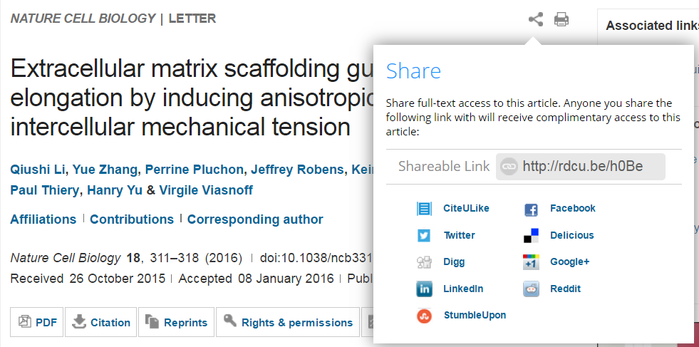
Content sharing – Enabling access worldwide
Notes:
How does content sharing work?
Well, after you publish in a Springer Nature journal, you simply go to the articles webpage. Here, you will see an option to share your published article. Click on this option to get the sharing options and the sharable link.

Slide 18
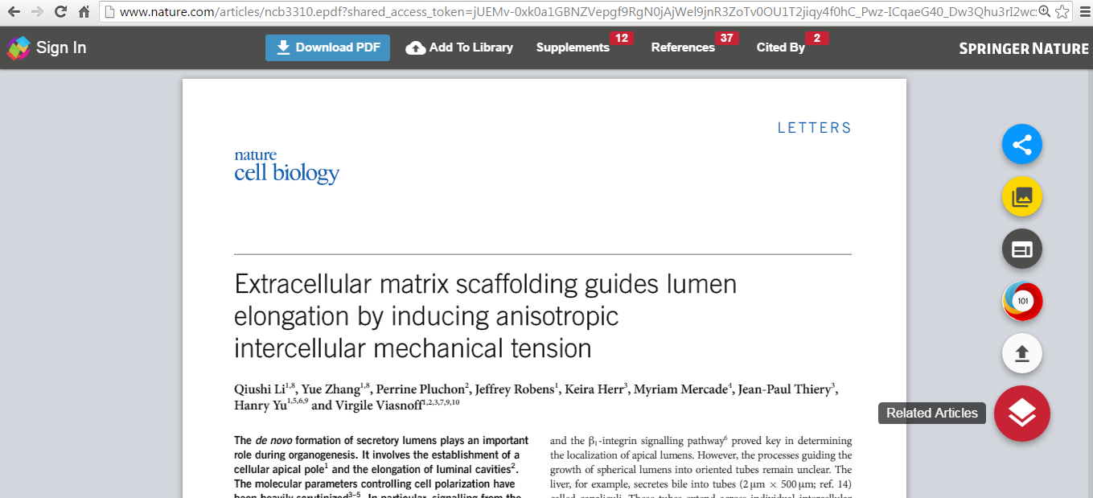
Content sharing – Enabling access worldwide
Can download if have subscription to journal
Useful article information
Even without subscription access, can still read article online for free
Notes:
When anyone clicks on the sharable link (for example from a tweet), they will be able to read your full-text article online. If they have subscription access to the journal, they can download the PDF. Valuable article information is conveniently displayed—that is why this is called an “Enhanced PDF”.
[As an aside, although anyone can read the full-text article online, they cannot download, print, or share the article.]
So in this last section, you have not only learned how to successfully navigate through the complex submission process and peer review, but also how to effectively promote your article worldwide to maximize your impact in the academic community.

Slide 19
Be an effective communicator
Logical manuscript structure
Effective publication strategy
Successful journal submission
You will increase your chance of publication and your research impact
Notes:
Today we have focused on being an effective communicator—ensuring that the information your readers are looking for can be found and understood quickly and efficiently.
We reviewed how to logically organize your ideas throughout your manuscript to effectively communicate them to your readers.
We then discussed how to choose the best journal for your manuscript to reach to the most appropriate audience.
Lastly we covered how to communicate the suitability of your manuscript to the journal editor and how to successfully navigate the peer review process.
By doing this, you will not only be published, but also more widely read in your field. This will lead to increased citations and build your reputation in the field, as well as that of your institution, worldwide.

